Slide 1
CSE 205 Digital Logic Design Week 6
Dr. Mahmuda Naznin

Slide 2
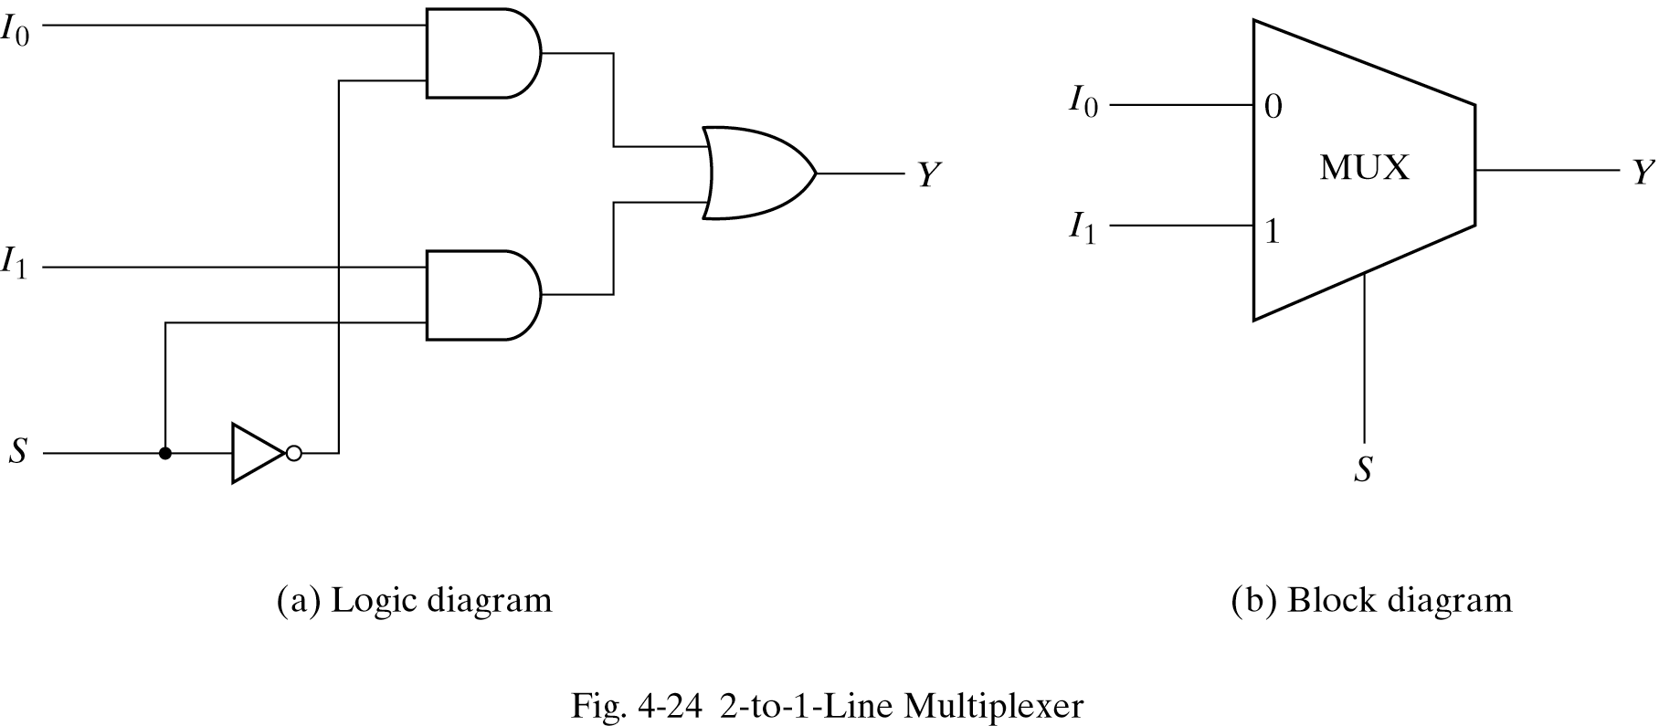
Multiplexers
Multiplexer: selects one binary input from many selections
example: 2-to-1 MUX

Slide 3
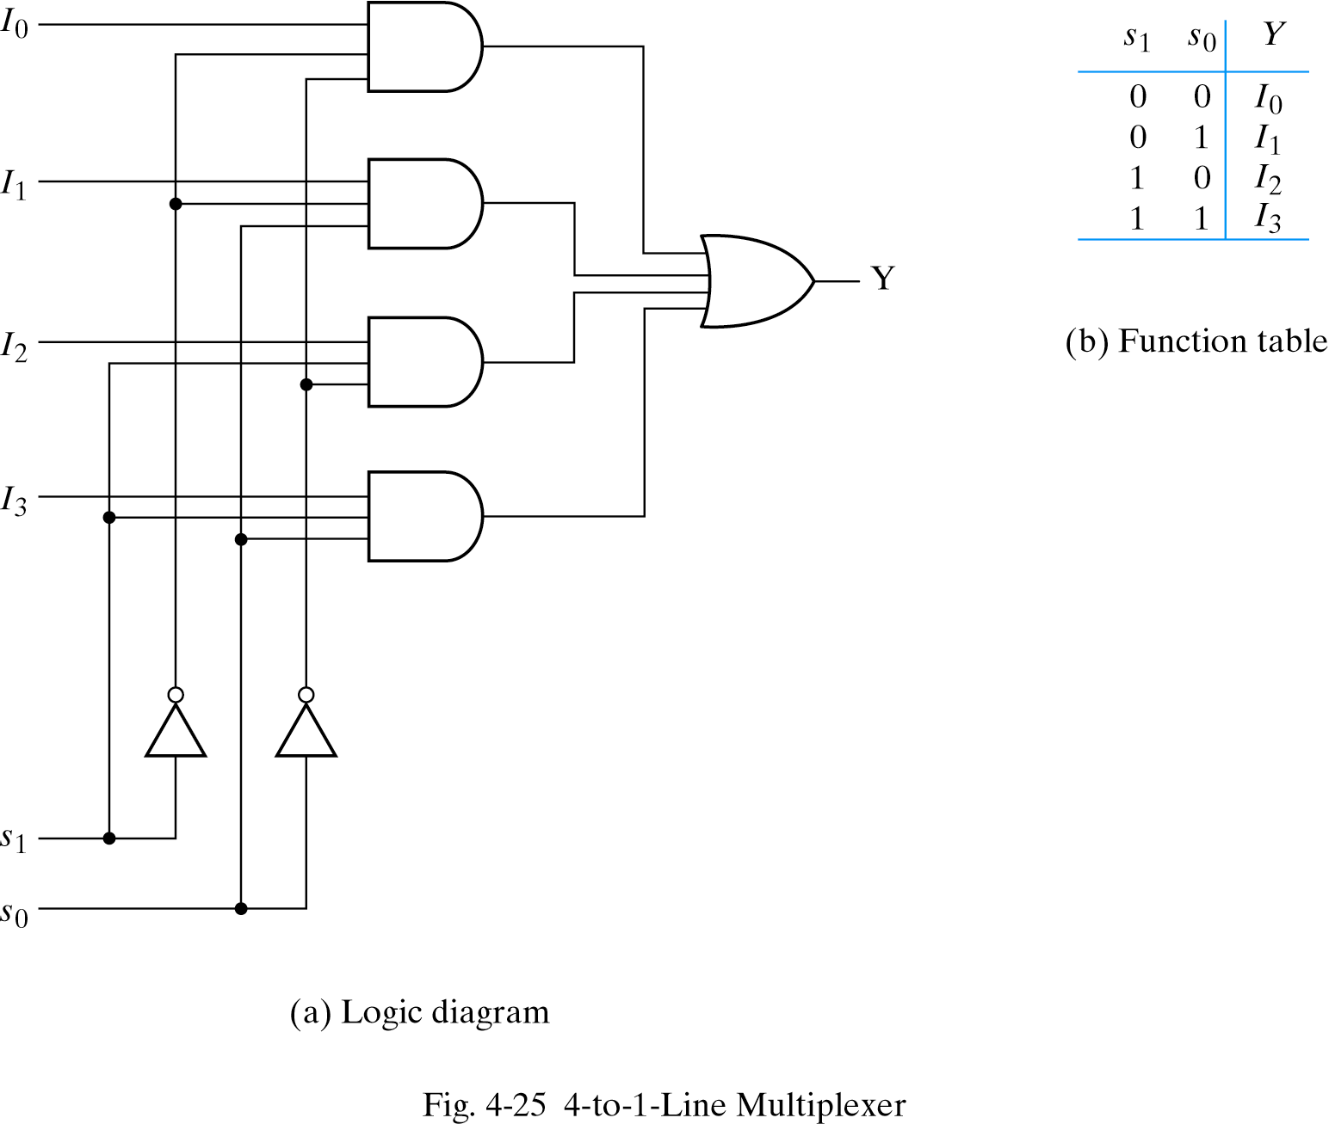
4-to-1 MUX
Directs 1 of the 4 inputs to the output

Slide 4
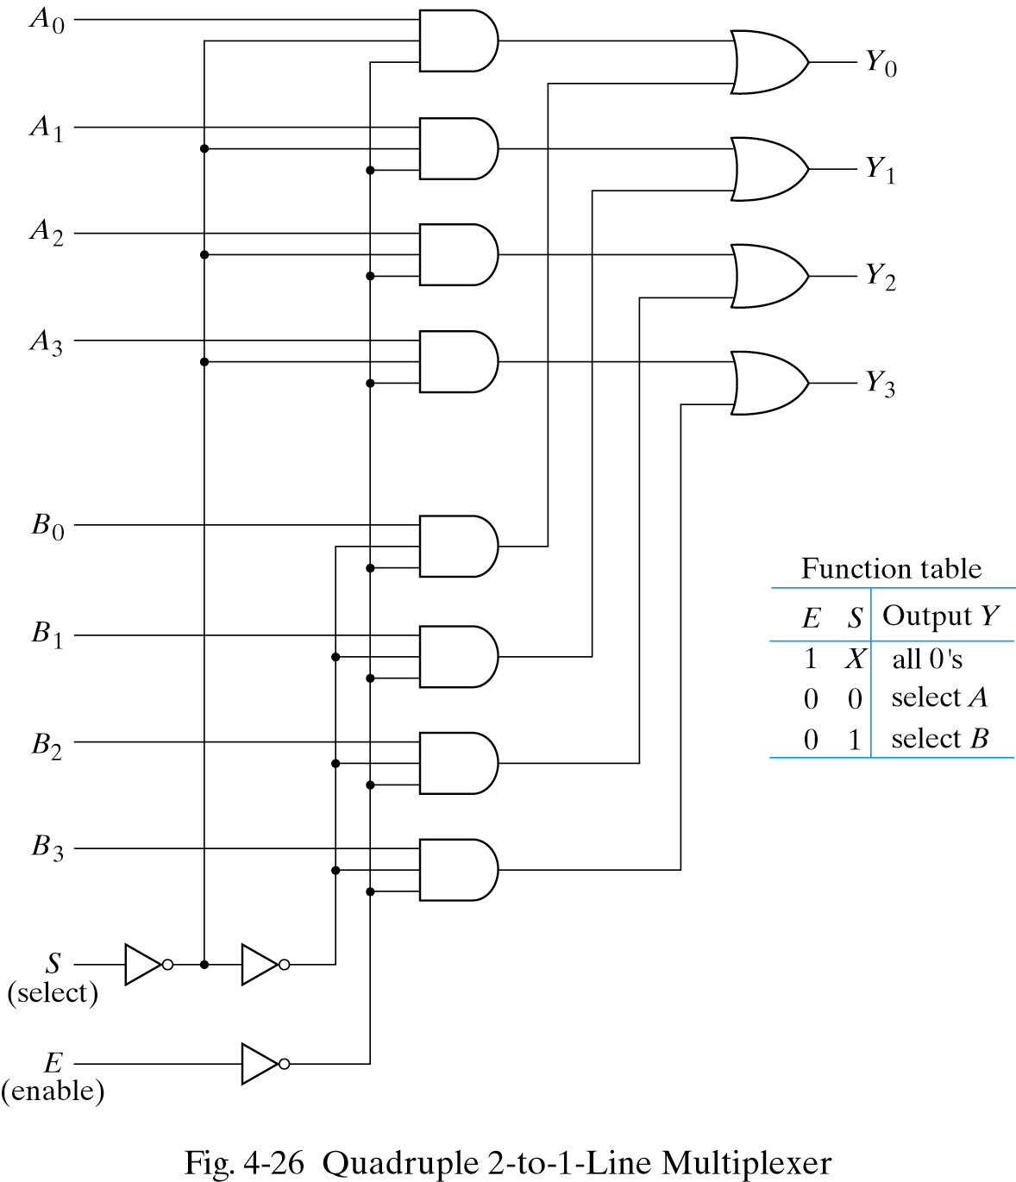
Multi-bit selection logic
Multiplexers can be combined with common selection inputs to support multi-bit selection logic

Slide 5
Implementing Boolean functions using MUX
General rules for implementing any Boolean function with n variables:
Use a multiplexer with n-1 selection inputs and 2 ^{n-1} data inputs
List the truth tabel
Apply the first n-1 variables to the selection inputs of multiplexer
For each combination evaluate the output as a function of the last variable.
The function can be 0, 1 the variable or the complement of the variable.

Slide 6
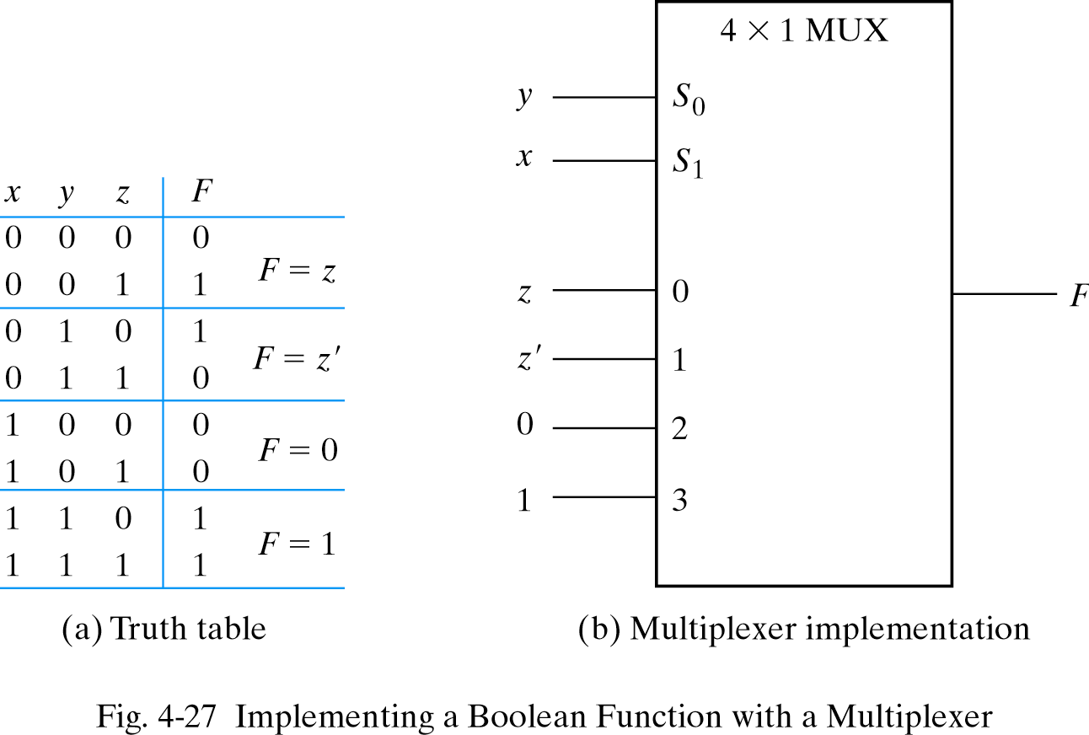
Implementing Boolean functions

Slide 7
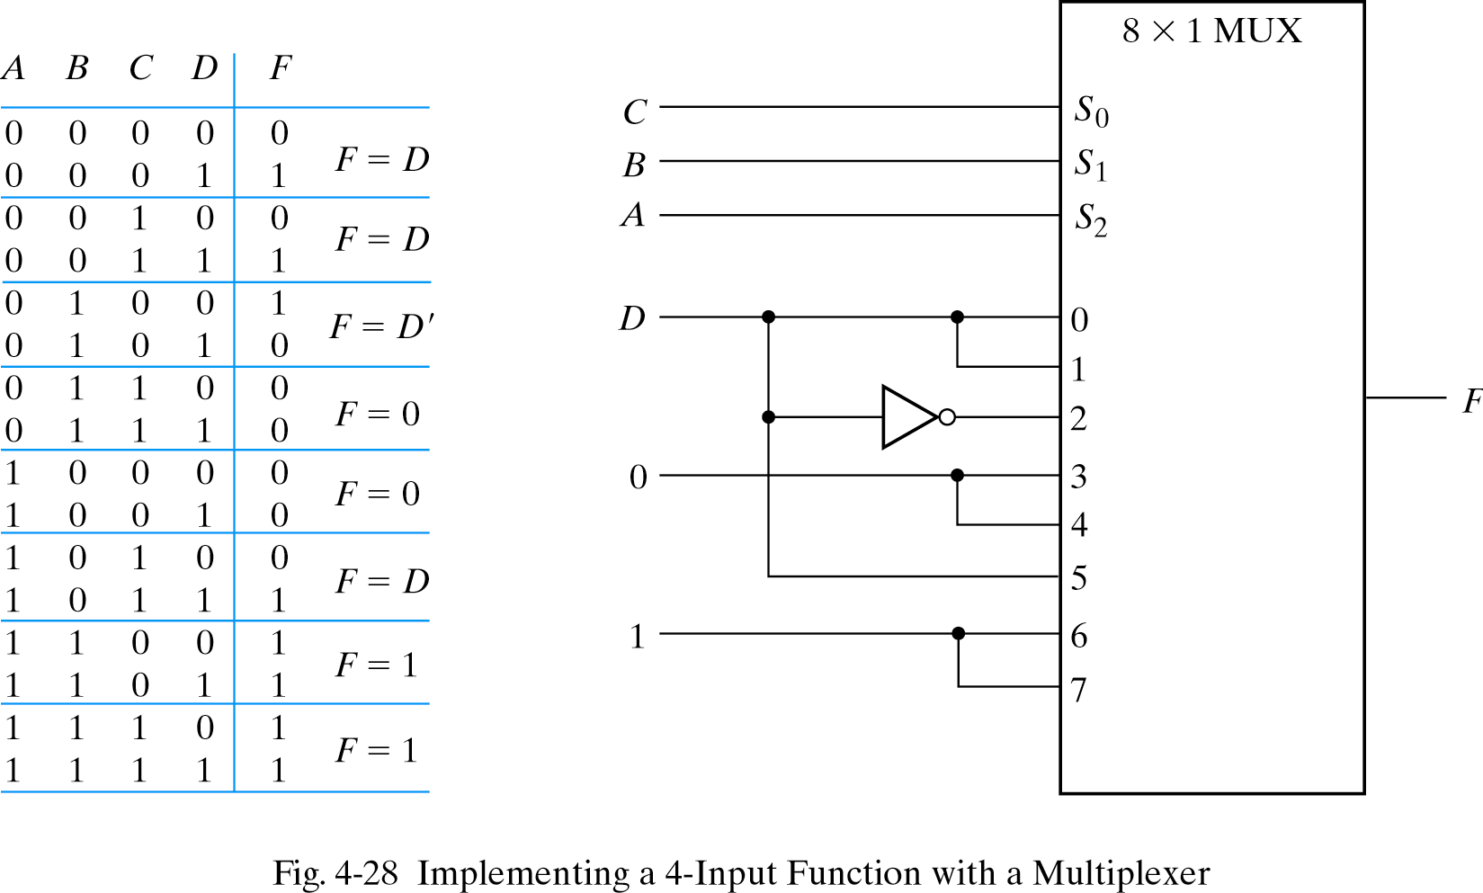
Implementing Boolean functions

Slide 8
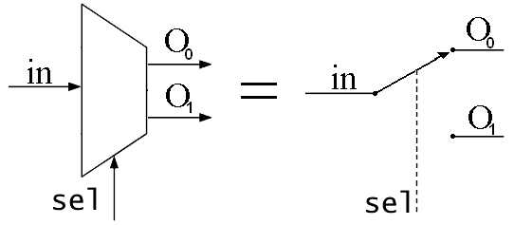
De-Multiplexer

Slide 9
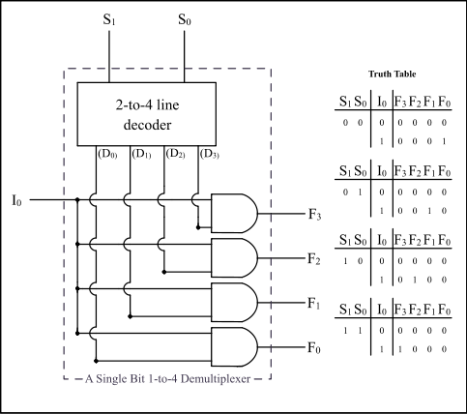
De-Multiplexer

Slide 10
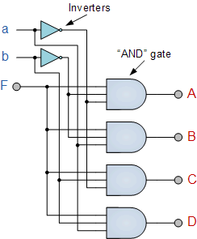
De-Multiplexer

